Slide 1
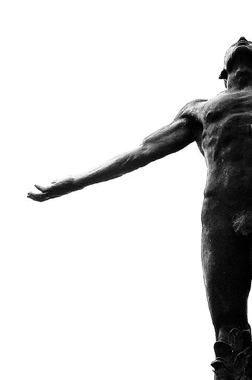
Machine Learning
Crash Course
Ian Jasper A. Agulo, Ph.D.
Department of Physical Sciences
College of Science, University of the Philippines Baguio

Slide 2

What is machine learning? Artificial intelligence?
Search
Maps
Pixel
Photos
Youtube
Assistant
Gmail
Ads
Cloud
https://blog.google/technology/ai/9-ways-we-use-ai-in-our-products/
Notes:
We’ve all heard a lot about machine learning and their various applications. And I’m sure that you’ve been using it without even knowing it.
Google describes 9 ways they use artificial intelligence in their products.
If you’re looking for a picture or a sound, Google’s AI search feature is able to search with images and text at the same time with the Google App. The AI behind Google Maps analyzes data to provide up-to-date information about traffic conditions and delays. YouTube uses AI to automatically generate captions for videos, making them more accessible to a wider audience, including those who are deaf or hard of hearing. Google Assistant uses a Natural Language Processing AI technology to understand and respond to your commands or question. Gmail uses AI to filter spam. And of course, the ads. Google uses the information provided by the user to provide them opportunities to expand their businesses and clients through ads.

Slide 3
Chat GPT, Google Bard, Microsoft Bing/Copilot, Claude, and Perplexity
Which is the Right AI Tool?
Which Chatbot Knows Best?
Battle of AI Chatbots
Samsung Galaxy S24 Series with Galaxy AI

Slide 4
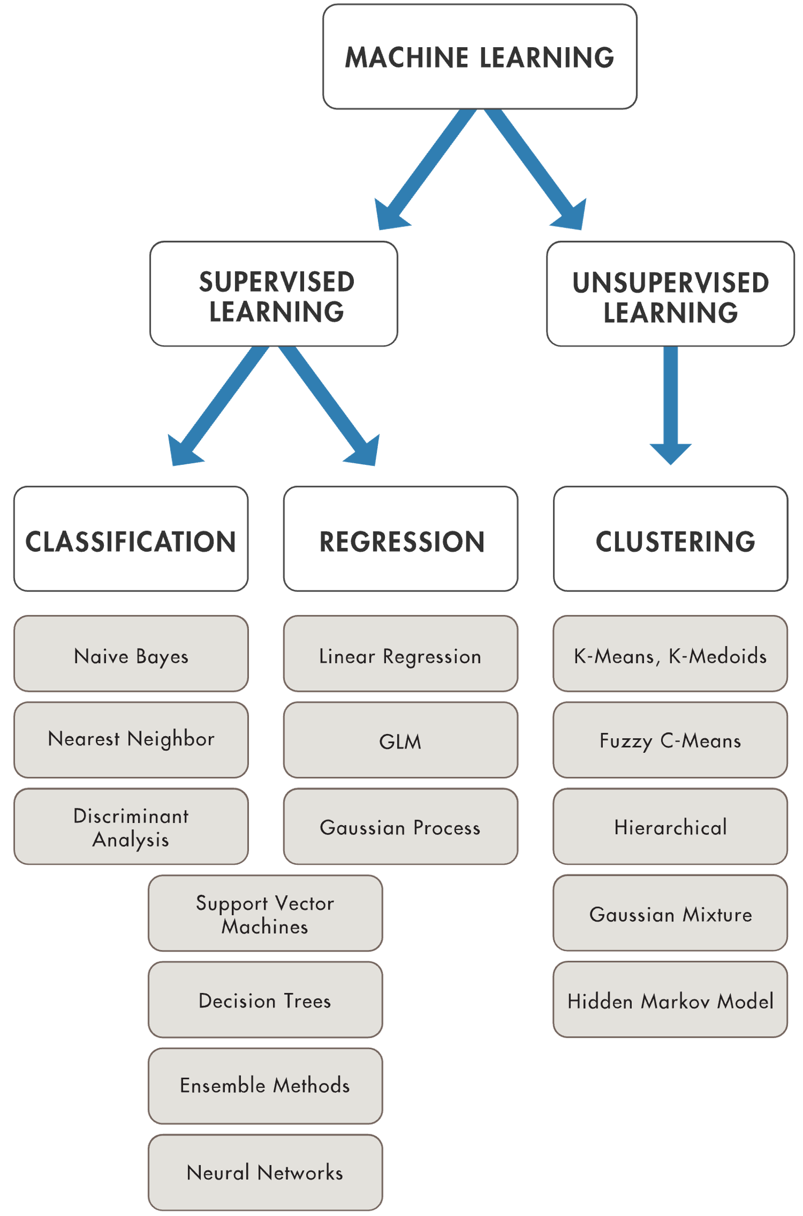
Machine learning can be divided into two categories – supervised learning and unsupervised learning.
Supervised learning is learning from a labelled data set, while unsupervised learning is learning from an unlabeled data set. An example of supervised learning is when you feed the machine pictures of various animals, you label the pictures based on the animal. On the other hand, if you let the computer find a pattern from a given unlabeled data that is not so obvious to us humans, the data becomes obvious because of these unsupervised machine learning algorithms.
https://www.mathworks.com/solutions/machine-learning.html
https://www.mathworks.com/help/stats/machine-learning-in-matlab.html

Slide 5
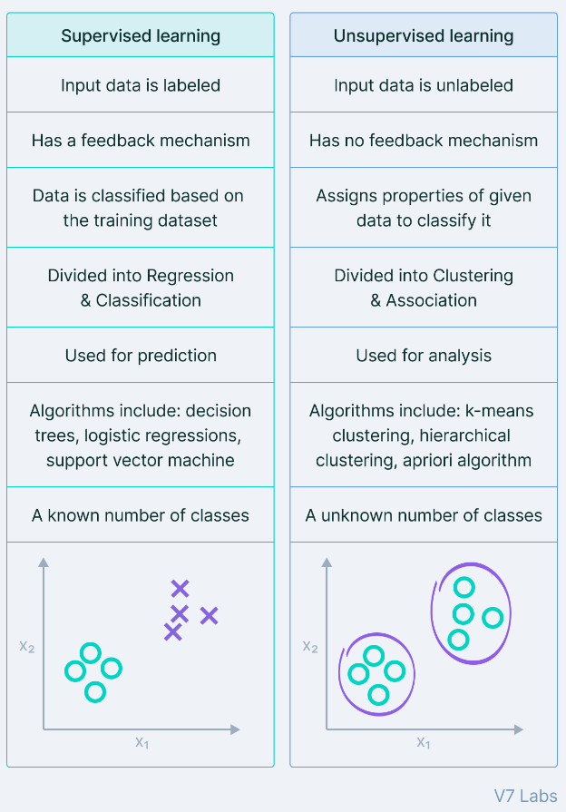
Supervised learning can be subdivided into two subgroups – classification and regression. Classification is nothing more than classifying objects or items, while an example of regression is stock market forecasting, weather forecasting, and population growth prediction. Under each subdivision, we have various algorithms or tools available.
In this course, our focus is on Supervised Learning using Neural Networks. We will consider examples on regression, perform a simple regression exercise, as well as a complex weather prediction exercise.
https://www.v7labs.com/blog/supervised-vs-unsupervised-learning

Slide 6
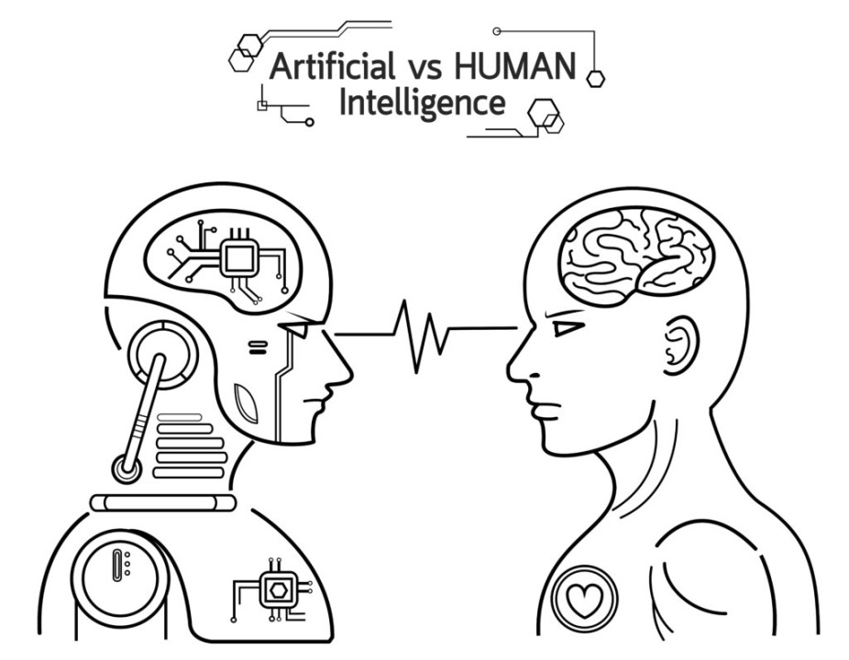
https://www.linkedin.com/pulse/battle-ai-human-intelligence-ajmal-muhammad-%E5%8F%AF%E6%B1%97/

Slide 7

https://medium.com/nerd-for-tech/the-ideal-workflow-for-your-machine-learning-project-9df1a7125b17

Slide 8


Slide 9
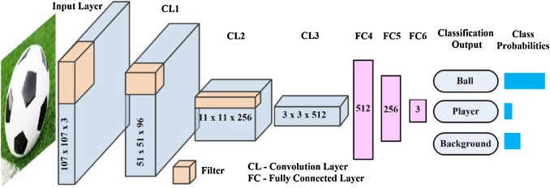
https://doi.org/10.1016/j.opelre.2019.02.003

Slide 10
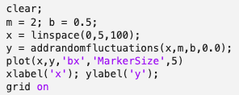
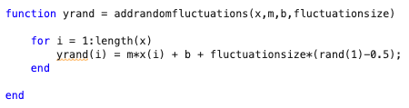
Setting Up the Dataset in MATLAB
Creates an array from 0 to 5 with 100 elements
Plots and y vs x, labels the axes and displays the grid lines
Function that adds fluctuations to the vertical data set
Linear component of yrand
Randomized component of yrand
Notes:
Let’s consider this simple example of fitting a linear data set using linear regression.
In this slide, you see the MATLAB code that generate a set of evenly spaced data.
The data set along the x-axis ranges from 0 to 5 with 100 data points.
The data set along the y-axis is generated using the function addrandomfluctuations(). The function takes in the x data set, the slope, m, the y-intercept, b, and the fluctuationsize, which I will explain in a bit.
This function generates the values of the y data set rom a simple linear equation of y = mx + b where m is the slope of the line and b is the y-intercept. However, I did add a random number at each data value for y just to give the data set a bit of a fluctuation to make it appear realistic. The size of the fluctuation is determined by the variable fluctuationsize.
Next, I set the values of the slope and the y-intercept before passing them on to the function.
Finally, the result is plotted.
Let’s run this program and see what happens. (Run for various values of fluctuationsize.)
As we see, the fluctuationsize gives the data set a more random looking data, which is what would you expect for a real data set.

Slide 11
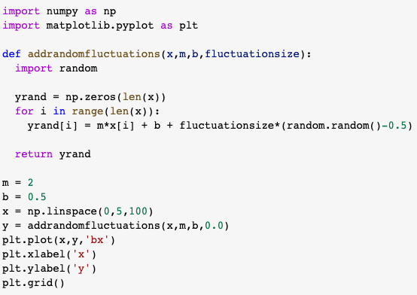
Setting Up the Dataset in Python
Function that adds fluctuations to the vertical data set
Creates an array from 0 to 5 with 100 elements
Linear component of yrand
Randomized component of yrand
Plots and y vs x, labels the axes and displays the grid lines
Notes:
In this slide, you see the Python code that generate a set of evenly spaced data.
The data set along the x-axis ranges from 0 to 5 with 100 data points.
The data set along the y-axis is generated using the function addrandomfluctuations(). The function takes in the x data set, the slope, m, the y-intercept, b, and the fluctuationsize, which I will explain in a bit.
This function generates the values of the y data set rom a simple linear equation of y = mx + b where m is the slope of the line and b is the y-intercept. However, I did add a random number at each data value for y just to give the data set a bit of a fluctuation to make it appear realistic. The size of the fluctuation is determined by the variable fluctuationsize.
Next, I set the values of the slope and the y-intercept before passing them on to the function.
Finally, the result is plotted.

Slide 12
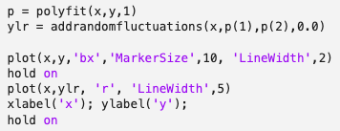
Linear Regression in MATLAB
Returns the coefficients for a polynomial that is a best fit for the data set
Generates a new data set, ylr, based on the coefficients, p
p(1) is the slope
p(2) is the y-intercept
Plots both y vs x and ylr vs x to ascertain that the coefficients, p, indeed is a best fit to the data set
Notes:
If we get this kind of data, it is easy for us to see that the data can be fitted by a straight line. To determine the exact description of the line, we solve for the slope of the line, m, and its y-intercept, b.
In this code, we used the MATLAB’s built-in linear regression function, called polyfit, and Python’s built-in linear regression function called linregress(). In Python, the linregress() function can be found in the SciPy module from its statistical function stats. Both functions give as output the slope and the y-intercept.
We use the addrandomfluctuations function to solve for the y data set, setting the fluctuation size to zero, and then plot the resulting line and compare it with the original generated data set.

Slide 13
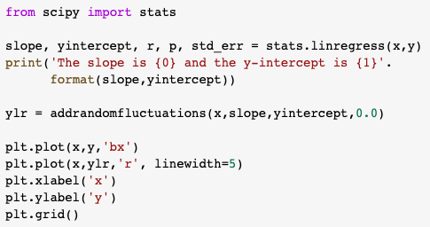
Linear Regression in Python
The function linregress() is found in the SciPy module
Returns the slope and yintercept for a linear function that is a best fit for the data set
Generates a new data set, ylr, based on the calculated slope and y-intercept
Plots both y vs x and ylr vs x to ascertain that the calculated slope and y-intercept indeed is a best fit to the data set
Notes:
Here, we use Python’s linear regression function called linregress(). In Python, the linregress() function can be found in the SciPy module from its statistical function stats. Both functions give as output the slope and the y-intercept.
We use the addrandomfluctuations function to solve for the y data set, setting the fluctuation size to zero, and then plot the resulting line and compare it with the original generated data set.

Slide 14
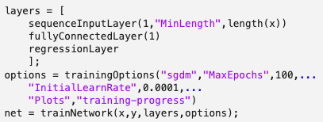
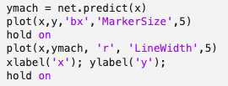
Simple Machine Learning Code for Linear Regression in MATLAB
Optimizer or algorithm that minimizes the error between the generated data set and the true data set
Command for training neural networks
Notes:
Here’s how we would train a computer to learn. Today, we’ll take a look at a few of the details of this code and understand what they mean and what they do.
I would just like to point out to you the functions trainNetwork() in MATLAB and fit() in Python that basically trains the computer by minimizing the error between the expected and actual. The algorithm or optimizer that they use to minimize the error is called stochastic gradient descent with momentum or ‘sgdm’ in MATLAB and ‘sgd’ in Python. You’ve studied gradient descent in computational physics. Stochastic gradient descent is similar to gradient descent, except that it trains on a piece of data or small batches of data instead of the whole data set. Because of this, it’s much faster to implement compared to gradient descent. The term stochastic pertains to the fact that the way it chooses the data to train on per iteration is randomized.

Slide 15
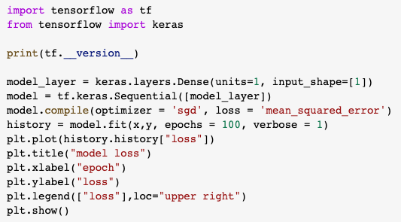
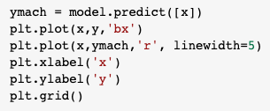
Simple Machine Learning Code for Linear Regression in Python
Command for training neural networks
Optimizer or algorithm that minimizes the error between the generated data set and the true data set
Notes:
Here’s how we would train a computer to learn. Today, we’ll take a look at a few of the details of this code and understand what they mean and what they do.
I would just like to point out to you the functions trainNetwork() in MATLAB and fit() in Python that basically trains the computer by minimizing the error between the expected and actual. The equation or algorithm that they use to minimize the error is called stochastic gradient descent with momentum or ‘sgdm’ in MATLAB and ‘sgd’ in Python. You’ve studied gradient descent in computational physics. Stochastic gradient descent is similar to gradient descent, except that it trains on a piece of data or small batches of data instead of the whole data set. Because of this, it’s much faster to implement compared to gradient descent. The term stochastic pertains to the fact that the way it chooses the data to train on per iteration is randomized.
Let’s take a look at this method of error minimization using gradient descent.

Slide 16
Gradient Descent
The method of gradient descent is a type of optimization method that explicitly uses the mathematical derivative to generate efficient algorithm to locate the optima, in this case, the minima
How do we apply this method to our data set to perform linear regression?
https://machinelearningmedium.com/2017/08/15/gradient-descent/

Slide 17
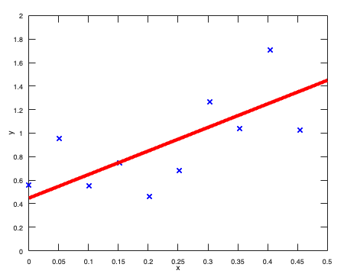
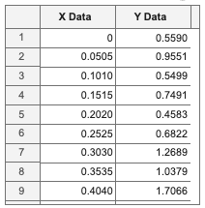
The goal here is to determine the equation of the line that best fits the data set. Consider our current data set. We display the first few data points in the figure below and we also present the corresponding tabulated data set.

Slide 18
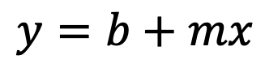
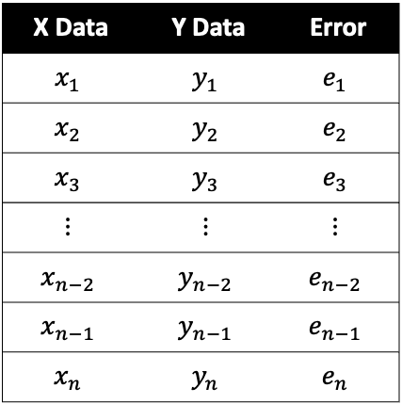
To generalize, the data set can be represented as (x₁, y₁), (x₂, y₂),…, (x_{n}, y_{n}).
X Data | Y Data | Error
$$x_{1}$$ | $$y_{1}$$ | $$e_{1}$$
$$x_{2}$$ | $$y_{2}$$ | $$e_{2}$$
$$x_{3}$$ | $$y_{3}$$ | $$e_{3}$$
$$⋮$$ | $$⋮$$ | $$⋮$$
$$x_{n−2}$$ | $$y_{n−2}$$ | $$e_{n−2}$$
$$x_{n−1}$$ | $$y_{n−1}$$ | $$e_{n−1}$$
$$x_{n}$$ | $$y_{n}$$ | $$e_{n}$$
The equation of the best line is given by $y=mx+b$, where m is the slope and b is the y-intercept. We are going to call this equation the hypothesis because we are going to make multiple guesses until the error between our hypothesis and the data set is minimized.
$$y=b+mx$$

Slide 19
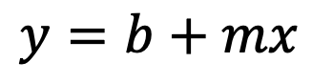
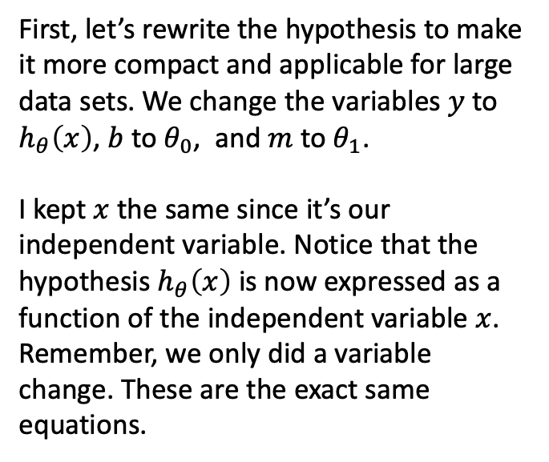
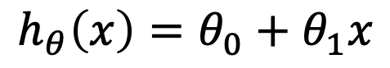
First, let’s rewrite the hypothesis to make it more compact and applicable for large data sets. We change the variables $y$ to $h_{θ}\left(x\right)$, $b$ to $θ_{0}$, and $m$ to $θ_{1}$.
I kept $x$ the same since it’s our independent variable. Notice that the hypothesis $h_{θ}\left(x\right)$ is now expressed as a function of the independent variable $x$. Remember, we only did a variable change. These are the exact same equations.
$$y=b+mx$$
Hypothesis:
$$h_{θ}\left(x\right)=θ_{0}+θ_{1}x$$

Slide 20
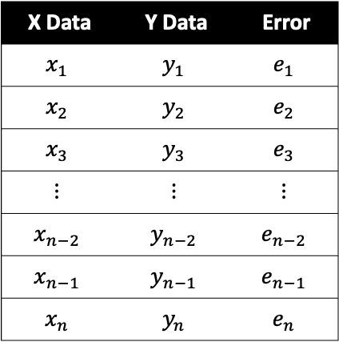
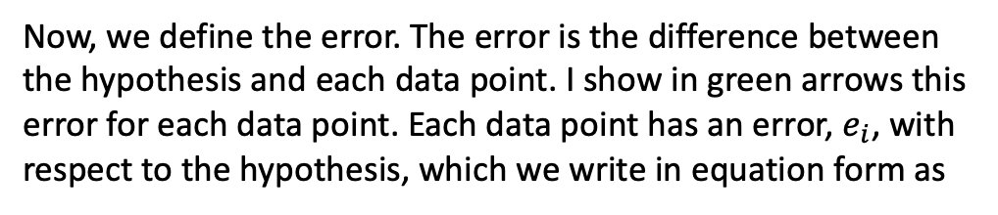
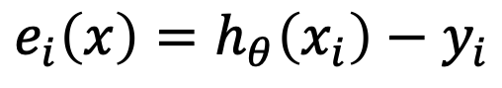
Now, we define the error. The error is the difference between the hypothesis and each data point. I show in green arrows this error for each data point. Each data point has an error, $e_{i}$, with respect to the hypothesis, which we write in equation form as
X Data | Y Data | Error
$$x_{1}$$ | $$y_{1}$$ | $$e_{1}$$
$$x_{2}$$ | $$y_{2}$$ | $$e_{2}$$
$$x_{3}$$ | $$y_{3}$$ | $$e_{3}$$
$$⋮$$ | $$⋮$$ | $$⋮$$
$$x_{n−2}$$ | $$y_{n−2}$$ | $$e_{n−2}$$
$$x_{n−1}$$ | $$y_{n−1}$$ | $$e_{n−1}$$
$$x_{n}$$ | $$y_{n}$$ | $$e_{n}$$
Error:
$$e_{i}\left(x\right)=h_{θ}\left(x_{i}\right)−y_{i}$$

Slide 21

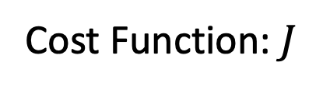
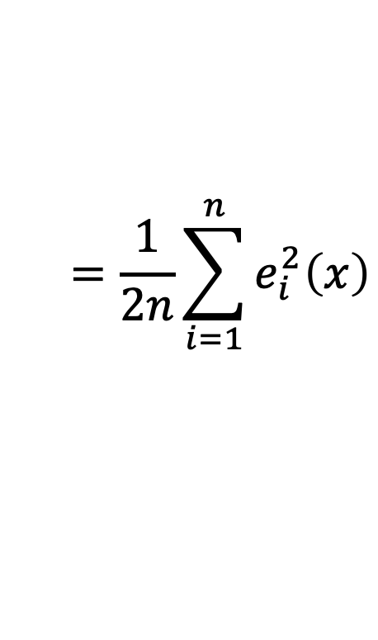
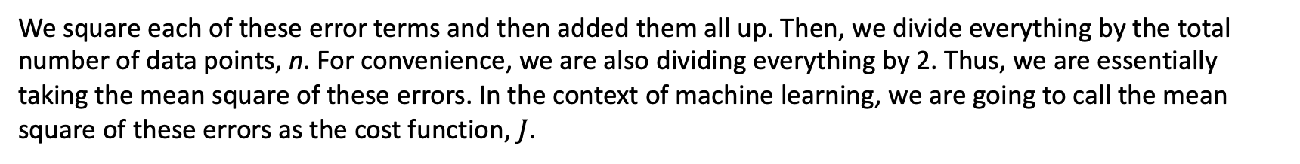
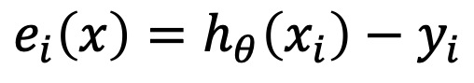
We square each of these error terms and then added them all up. Then, we divide everything by the total number of data points, n. For convenience, we are also dividing everything by 2. Thus, we are essentially taking the mean square of these errors. In the context of machine learning, we are going to call the mean square of these errors as the cost function, $J$.
X Data | Y Data | Error
$$x_{1}$$ | $$y_{1}$$ | $$e_{1}$$
$$x_{2}$$ | $$y_{2}$$ | $$e_{2}$$
$$x_{3}$$ | $$y_{3}$$ | $$e_{3}$$
$$⋮$$ | $$⋮$$ | $$⋮$$
$$x_{n−2}$$ | $$y_{n−2}$$ | $$e_{n−2}$$
$$x_{n−1}$$ | $$y_{n−1}$$ | $$e_{n−1}$$
$$x_{n}$$ | $$y_{n}$$ | $$e_{n}$$
Error:
$$e_{i}\left(x\right)=h_{θ}\left(x_{i}\right)−y_{i}$$
$$=\frac{1}{2n}\sum_{i=1}^{n}{e_{i}^{2}\left(x\right)}$$
Cost Function: $J$

Slide 22
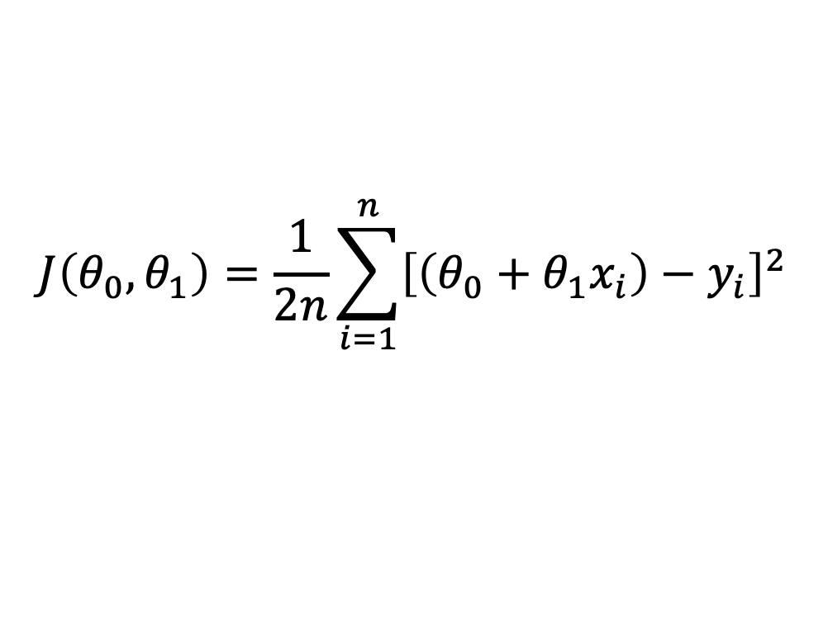
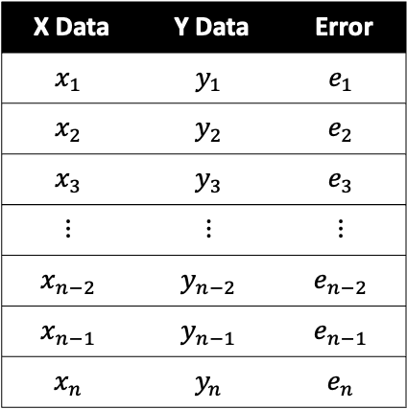
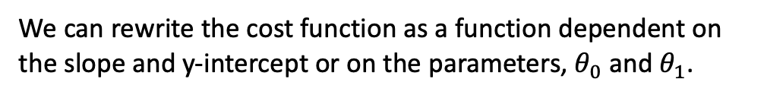
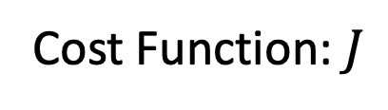
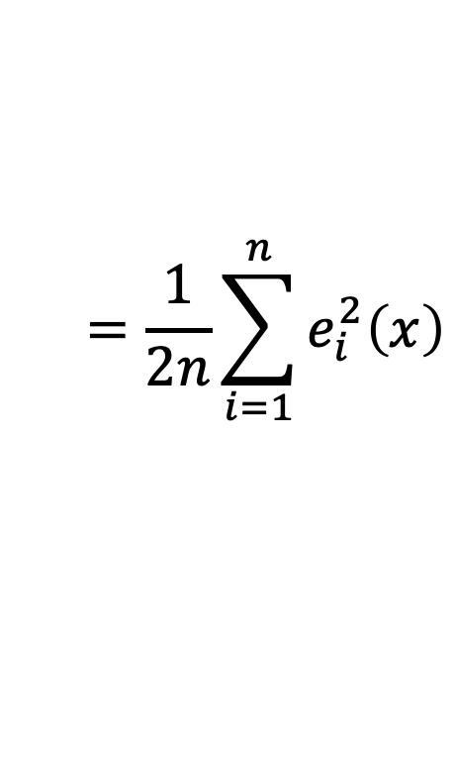
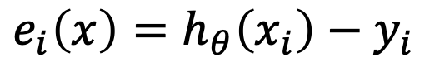
We can rewrite the cost function as a function dependent on the slope and y-intercept or on the parameters, $θ_{0}$ and $θ_{1}$.
X Data | Y Data | Error
$$x_{1}$$ | $$y_{1}$$ | $$e_{1}$$
$$x_{2}$$ | $$y_{2}$$ | $$e_{2}$$
$$x_{3}$$ | $$y_{3}$$ | $$e_{3}$$
$$⋮$$ | $$⋮$$ | $$⋮$$
$$x_{n−2}$$ | $$y_{n−2}$$ | $$e_{n−2}$$
$$x_{n−1}$$ | $$y_{n−1}$$ | $$e_{n−1}$$
$$x_{n}$$ | $$y_{n}$$ | $$e_{n}$$
Error:
$$e_{i}\left(x\right)=h_{θ}\left(x_{i}\right)−y_{i}$$
$$=\frac{1}{2n}\sum_{i=1}^{n}{e_{i}^{2}\left(x\right)}$$
Cost Function: $J$
$$J\left(θ_{0},θ_{1}\right)=\frac{1}{2n}\sum_{i=1}^{n}{{\left[\left(θ_{0}+θ_{1}x_{i}\right)−y_{i}\right]}^{2}}$$

Slide 23
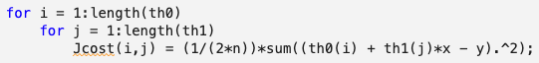
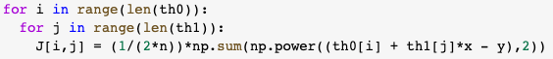
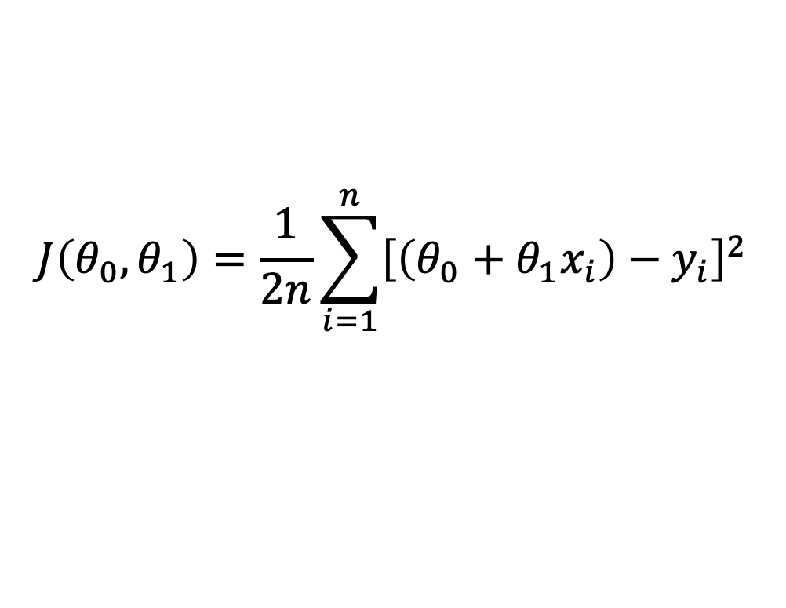
Implementing the cost function in code is simple. One just needs to define the values of the slope and the y-intercept and simply plug it in the equation.
$$J\left(θ_{0},θ_{1}\right)=\frac{1}{2n}\sum_{i=1}^{n}{{\left[\left(θ_{0}+θ_{1}x_{i}\right)−y_{i}\right]}^{2}}$$
J = (1/(2*n))*sum((th0 + th1*x - y).^2);
In the actual implementation of the code, you will see that the cost function is written in the form of a for loop, which is not very efficient. The only reason for this is to be able to plot and display the cost function in real time in relation to the data set and the 2D or 3D space per iteration.

Slide 24
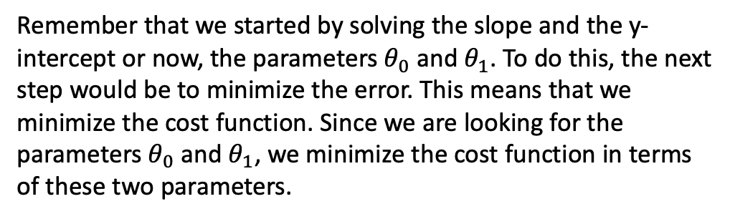
Remember that we started by solving the slope and the y-intercept or now, the parameters $θ_{0}$ and $θ_{1}$. To do this, the next step would be to minimize the error. This means that we minimize the cost function. Since we are looking for the parameters $θ_{0}$ and $θ_{1}$, we minimize the cost function in terms of these two parameters.
$$J\left(θ_{0},θ_{1}\right)=\frac{1}{2n}\sum_{i=1}^{n}{{\left[\left(θ_{0}+θ_{1}x_{i}\right)−y_{i}\right]}^{2}}$$
Cost Function:
Notes:
First, let’s try to understand what we expect to happen. Let’s set the y-intercept to $θ_{0}=0.5$ and then vary the slope of the line, $θ_{1}$. While we vary the slope, we also take a look at the cost function. Watch this video and try to figure out what the value of $θ_{1}$ that corresponds to the minimum of the cost function.
We can see that when the slope $θ_{1}=0$, the difference between the hypothesis (the red line) and the data set is huge and the error of the cost function is huge as well. As the slope changes value from 0 to 2, we see that the cost function decreases until it reaches a minimum value. At that minimum value, the hypothesis precisely overlaps the data set. As we continue to increase the slope, the cost function increases again, and the hypothesis deviates once more from all the data set. The resulting plot of the cost function vs the slope takes the shape of a parabola with a minimum value at around $θ_{1}=2$, which is what we expect.
We see a similar behavior when we vary the y-intercept, $θ_{0}$, instead of the slope, $θ_{1}$, which you can see in the accompanying MATLAB and Python codes.

Slide 25
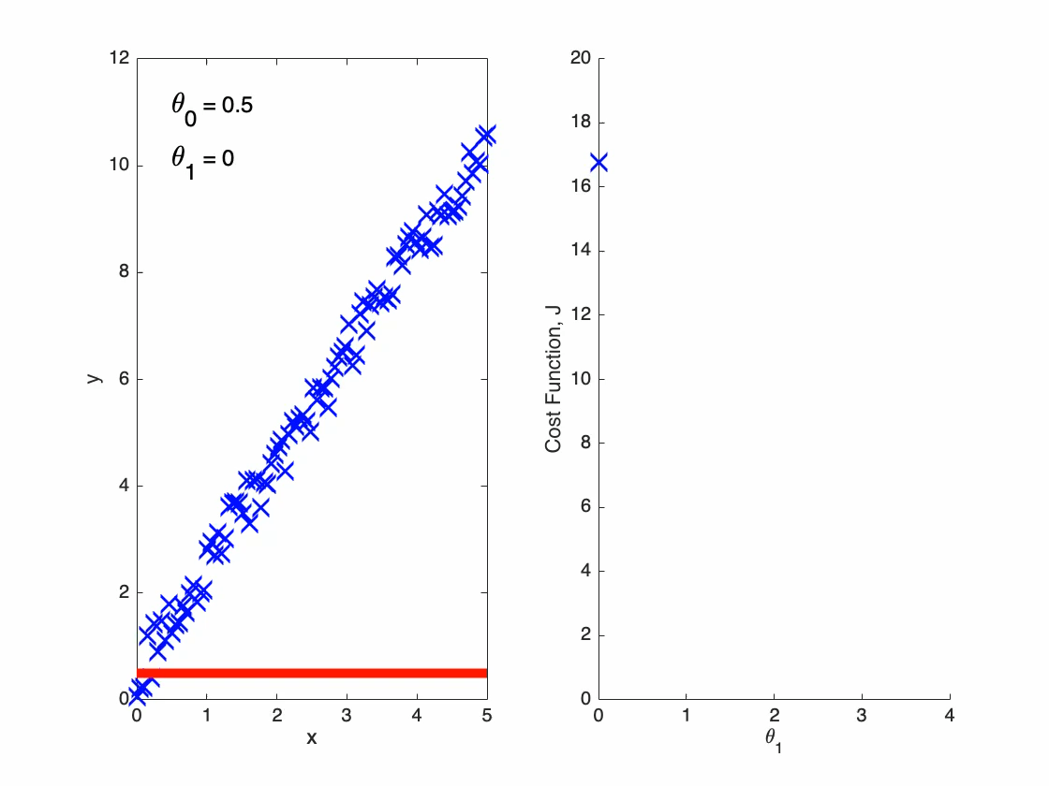
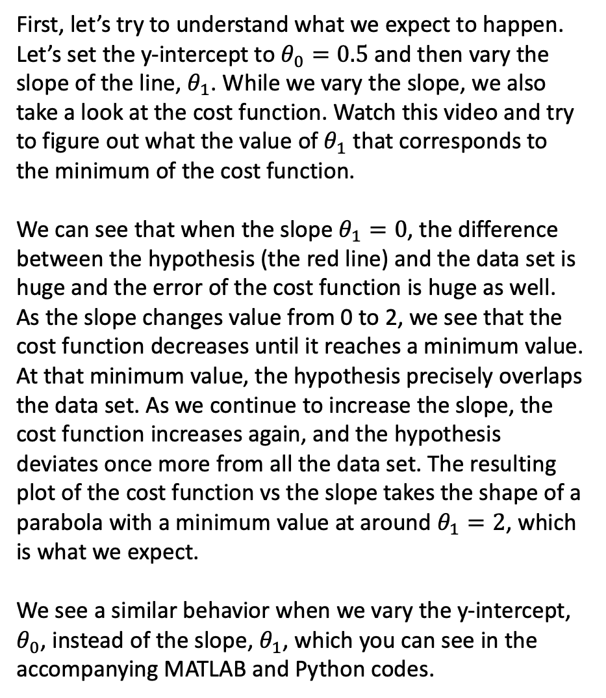
First, let’s try to understand what we expect to happen. Let’s set the y-intercept to $θ_{0}=0.5$ and then vary the slope of the line, $θ_{1}$. While we vary the slope, we also take a look at the cost function. Watch this video and try to figure out what the value of $θ_{1}$ that corresponds to the minimum of the cost function.
We can see that when the slope $θ_{1}=0$, the difference between the hypothesis (the red line) and the data set is huge and the error of the cost function is huge as well. As the slope changes value from 0 to 2, we see that the cost function decreases until it reaches a minimum value. At that minimum value, the hypothesis precisely overlaps the data set. As we continue to increase the slope, the cost function increases again, and the hypothesis deviates once more from all the data set. The resulting plot of the cost function vs the slope takes the shape of a parabola with a minimum value at around $θ_{1}=2$, which is what we expect.
We see a similar behavior when we vary the y-intercept, $θ_{0}$, instead of the slope, $θ_{1}$, which you can see in the accompanying MATLAB and Python codes.

Slide 26
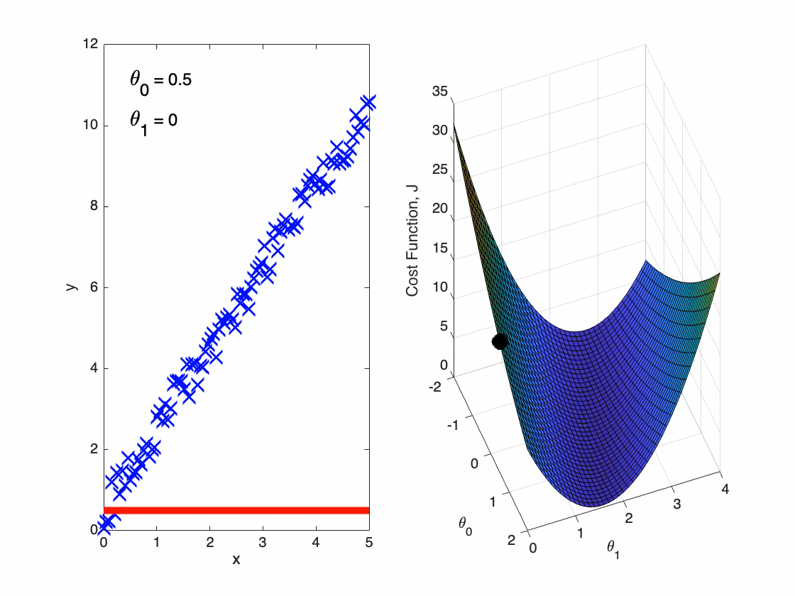
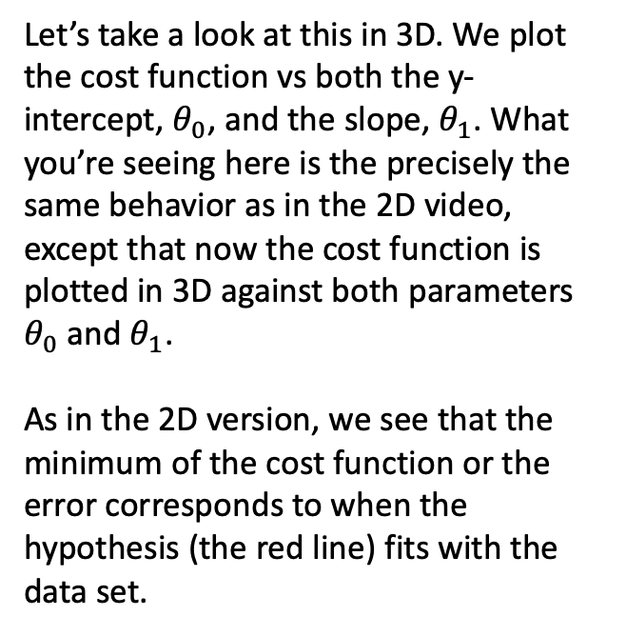
Let’s take a look at this in 3D. We plot the cost function vs both the y-intercept, $θ_{0}$, and the slope, $θ_{1}$. What you’re seeing here is the precisely the same behavior as in the 2D video, except that now the cost function is plotted in 3D against both parameters $θ_{0}$ and $θ_{1}$.
As in the 2D version, we see that the minimum of the cost function or the error corresponds to when the hypothesis (the red line) fits with the data set.

Slide 27
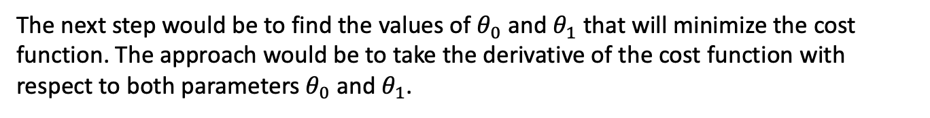
The next step would be to find the values of $θ_{0}$ and $θ_{1}$ that will minimize the cost function. The approach would be to take the derivative of the cost function with respect to both parameters $θ_{0}$ and $θ_{1}$.
$$J\left(θ_{0},θ_{1}\right)=\frac{1}{2n}\sum_{i=1}^{n}{{\left[\left(θ_{0}+θ_{1}x_{i}\right)−y_{i}\right]}^{2}}$$
Cost Function:
So, if we do this, we’ll get the following derivatives of the cost function:
$$\frac{∂J\left(θ_{0},θ_{1}\right)}{∂θ_{0}}=\frac{1}{n}\sum_{i=1}^{n}{\left[\left(θ_{0}+θ_{1}x_{i}\right)−y_{i}\right]}$$
Derivatives of the Cost Function:
$$\frac{∂J\left(θ_{0},θ_{1}\right)}{∂θ_{1}}=\frac{1}{n}\sum_{i=1}^{n}{\left[\left(θ_{0}+θ_{1}x_{i}\right)−y_{i}\right]x_{i}}$$

Slide 28
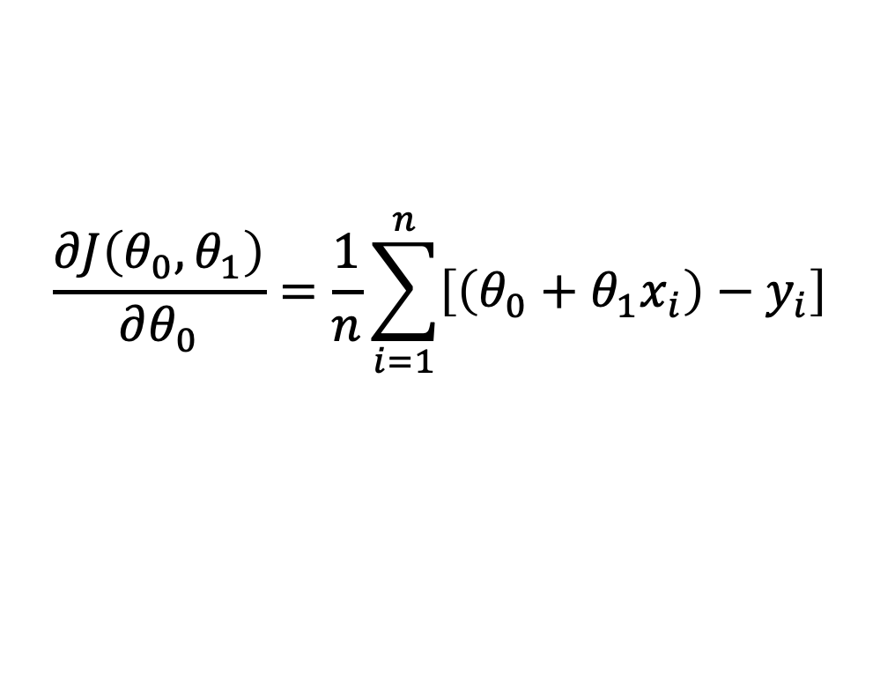
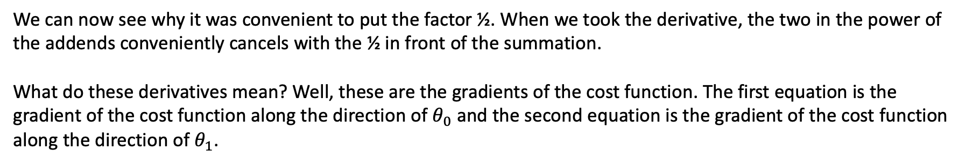
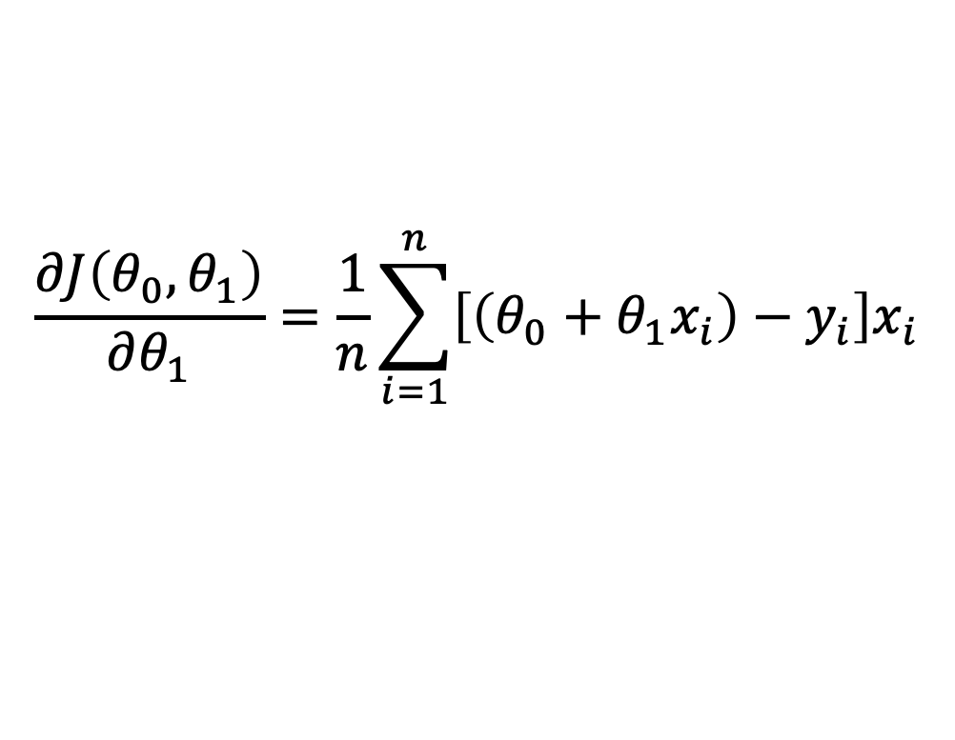
We can now see why it was convenient to put the factor ½. When we took the derivative, the two in the power of the addends conveniently cancels with the ½ in front of the summation.
What do these derivatives mean? Well, these are the gradients of the cost function. The first equation is the gradient of the cost function along the direction of $θ_{0}$ and the second equation is the gradient of the cost function along the direction of $θ_{1}$.
$$\frac{∂J\left(θ_{0},θ_{1}\right)}{∂θ_{0}}=\frac{1}{n}\sum_{i=1}^{n}{\left[\left(θ_{0}+θ_{1}x_{i}\right)−y_{i}\right]}$$
Derivatives of the Cost Function:
$$\frac{∂J\left(θ_{0},θ_{1}\right)}{∂θ_{1}}=\frac{1}{n}\sum_{i=1}^{n}{\left[\left(θ_{0}+θ_{1}x_{i}\right)−y_{i}\right]x_{i}}$$

Slide 29
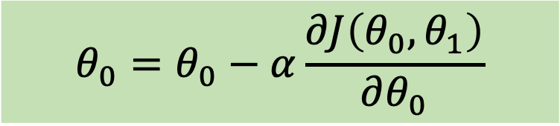
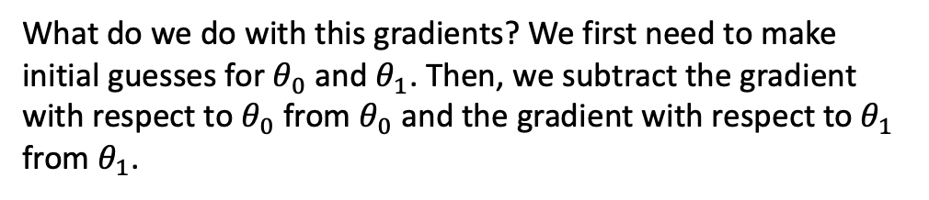
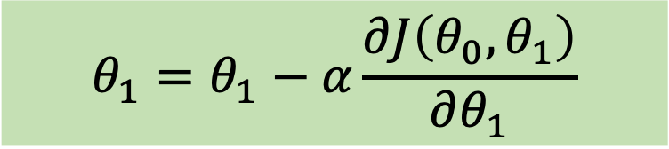
What do we do with this gradients? We first need to make initial guesses for $θ_{0}$ and $θ_{1}$. Then, we subtract the gradient with respect to $θ_{0}$ from $θ_{0}$ and the gradient with respect to $θ_{1}$ from $θ_{1}$.
$$θ_{0}=θ_{0}−α\frac{∂J\left(θ_{0},θ_{1}\right)}{∂θ_{0}}$$
Gradient Descent:
$$θ_{1}=θ_{1}−α\frac{∂J\left(θ_{0},θ_{1}\right)}{∂θ_{1}}$$

Slide 30
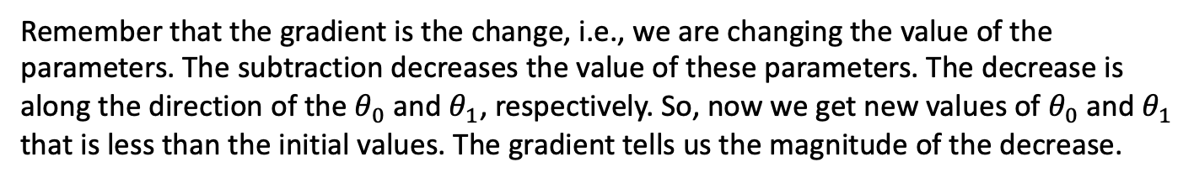
Remember that the gradient is the change, i.e., we are changing the value of the parameters. The subtraction decreases the value of these parameters. The decrease is along the direction of the $θ_{0}$ and $θ_{1}$, respectively. So, now we get new values of $θ_{0}$ and $θ_{1}$ that is less than the initial values. The gradient tells us the magnitude of the decrease.
$$θ_{0}=θ_{0}−α\frac{∂J\left(θ_{0},θ_{1}\right)}{∂θ_{0}}$$
Gradient Descent:
$$θ_{1}=θ_{1}−α\frac{∂J\left(θ_{0},θ_{1}\right)}{∂θ_{1}}$$
Notes:
$$θ_{0}=θ_{0}−α\frac{∂J\left(θ_{0},θ_{1}\right)}{∂θ_{0}}$$
$$θ_{1}=θ_{1}−α\frac{∂J\left(θ_{0},θ_{1}\right)}{∂θ_{1}}$$
If we repeat the process, use these new parameter values into the derivatives of the cost function, we get a new gradient, and then new parameter values, which is also less than the previous values. If we keep doing this, we eventually end up at the lowest values of the parameters, which corresponds to the minimum of the cost function.

Slide 31
If we repeat the process, use these new parameter values into the derivatives of the cost function, we get a new gradient, and then new parameter values, which is also less than the previous values. If we keep doing this, we eventually end up at the lowest values of the parameters, which corresponds to the minimum of the cost function.
$$θ_{0}=θ_{0}−α\frac{∂J\left(θ_{0},θ_{1}\right)}{∂θ_{0}}$$
Gradient Descent:
$$θ_{1}=θ_{1}−α\frac{∂J\left(θ_{0},θ_{1}\right)}{∂θ_{1}}$$

Slide 32




$$J\left(θ_{0},θ_{1}\right)=\frac{1}{2n}\sum_{i=1}^{n}{{\left[\left(θ_{0}+θ_{1}x_{i}\right)−y_{i}\right]}^{2}}$$
Jcost(i) = (1/(2*n))*sum((t0(i) + t1(i)*x - y).^2);
% Solve for the derivative
gradJcost0(i) = (1/n)*sum(t0(i) + t1(i)*x - y);
gradJcost1(i) = (1/n)*sum((t0(i) + t1(i)*x - y).*x);
% Get new values of the parameters
t0(i+1) = t0(i) - a*gradJcost0(i);
t1(i+1) = t1(i) - a*gradJcost1(i);
$$\frac{∂J\left(θ_{0},θ_{1}\right)}{∂θ_{0}}=\frac{1}{n}\sum_{i=1}^{n}{\left[\left(θ_{0}+θ_{1}x_{i}\right)−y_{i}\right]}$$
$$\frac{∂J\left(θ_{0},θ_{1}\right)}{∂θ_{1}}=\frac{1}{n}\sum_{i=1}^{n}{\left[\left(θ_{0}+θ_{1}x_{i}\right)−y_{i}\right]x_{i}}$$
$$θ_{i}=θ_{i}−α\frac{∂J\left(θ_{0},θ_{1}\right)}{∂θ_{i}}, i=0,1$$
Notes:
Take a look at the function gradient_descent() and see how this is implemented in code.

Slide 33





$$J\left(θ_{0},θ_{1}\right)=\frac{1}{2n}\sum_{i=1}^{n}{{\left[\left(θ_{0}+θ_{1}x_{i}\right)−y_{i}\right]}^{2}}$$
$$\frac{∂J\left(θ_{0},θ_{1}\right)}{∂θ_{0}}=\frac{1}{n}\sum_{i=1}^{n}{\left[\left(θ_{0}+θ_{1}x_{i}\right)−y_{i}\right]}$$
$$\frac{∂J\left(θ_{0},θ_{1}\right)}{∂θ_{1}}=\frac{1}{n}\sum_{i=1}^{n}{\left[\left(θ_{0}+θ_{1}x_{i}\right)−y_{i}\right]x_{i}}$$
$$θ_{i}=θ_{i}−α\frac{∂J\left(θ_{0},θ_{1}\right)}{∂θ_{i}}, i=0,1$$

Slide 34


Now, I’d like to point out to you another parameter of importance that is present in these gradient descent equations. You may have noticed that there’s a parameter, $α$, which is a coefficient of the gradient. This parameter is called the learning rate and is quite significant in terms of how fast or slow we want our machine to learn. It’s best to understand what this parameter does with a visual demonstration.
The Learning Rate, $α$
$$θ_{0}=θ_{0}−α\frac{∂J\left(θ_{0},θ_{1}\right)}{∂θ_{0}}$$
% Get new values of the parameters
t0(i+1) = t0(i) - a*gradJcost0(i);
t1(i+1) = t1(i) - a*gradJcost1(i);
Gradient Descent:
$$θ_{1}=θ_{1}−α\frac{∂J\left(θ_{0},θ_{1}\right)}{∂θ_{1}}$$

Slide 35


The learning rate was set to $α=0.2$
First, we choose initial values for $θ_{0}$ and $θ_{1}$. In this example, I used initial values of $θ_{0}=−2$ and $θ_{1}=0$, all the way up from the corner of the cost function plot, just to clearly see how the parameters change values as it goes down to the minimum value. Taking a look at the data set and the hypothesis, $θ_{0}=−2$ and $θ_{1}=0$ means that the slope is zero and the y-intercept is -2, which is what we see in the graph.
When we run the program, we see that the parameter values descends toward the minimum, while at the same time, the hypothesis also begins to approach the data set.

Slide 36


Here we set the learning rate, $α=0.1$. With the value for the learning rate, we see that from the first iteration to the second iteration, the parameter values goes immediately near the optimum values. As the iteration proceeds, it slowly comes closer and closer to the optimum value. Let’s decrease the learning rate by half.

Slide 37


Here we set the learning rate, $α=0.05$. We see that the parameter values also makes a big jump but not as big as the when the learning rate was twice as much. It approaches the optimum value slower. Let’s decrease the learning rate even more.

Slide 38


Here we set the learning rate, $α=0.01$. We can see that the descent is even slower when we decreased the learning rate further.

Slide 39


Let’s take one more look when the learning rate is increased to $α=0.5$. Now, it becomes even more erratic and diverges as you can see from the large values of the cost function going all the way up to values of ${10}^{55}$!

Slide 40

We’ve learned that if we choose a small value for the learning rate, the convergence to the optimum value is quite slow, and that if we choose a high value for the learning rate, it becomes faster. If it’s too high, then the parameters actually diverges and will never reach the optimum value. Thus, the learning rate needs to be selected properly in order to allow for a fast but accurate convergence towards the optimum value.
Small $α$– converges to minimum slowly
Large $α$ – converges to minimum faster
Too large $α$ – may not reach convergence

Slide 41

Let’s revert back to a learning rate of $α=0.2$, which seems to be the optimum value for the learning rate. Let’s also increase the number of iterations. We can see that with this learning rate the parameters eventually reach the optimum value after a large number of iterations.

